Slide 1
10.0 Z-Transform
10.1 General Principles of
Z-Transform
Z-Transform
Eigenfunction Property
x[n] = z^{n}
y[n] = H(z)z^{n}
h[n]
linear, time-invariant

Slide 2
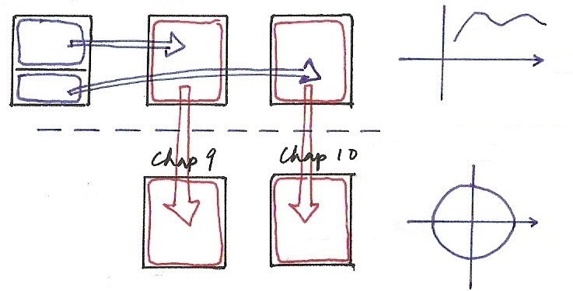
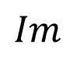
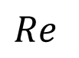
Chapters 3, 4, 5, 9, 10 (p.2 of 9.0)
jω
Chap 9
Chap 3
Chap 4
Chap 5
Chap 10

Slide 3
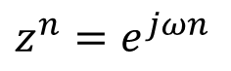
Z-Transform
Eigenfunction Property
applies for all complex variables z
$$z^{n}=e^{jωn}$$
Fourier Transform
Z-Transform
Z-Transform

Slide 4
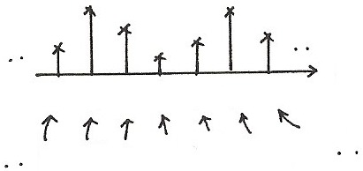
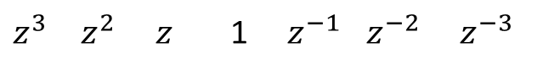
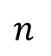
Z-Transform
$$n$$
-3 -2 -1 0 1 2 3
$z^{3}$ $z^{2}$ $z$ 1 $z^{−1}$ $z^{−2}$ $z^{−3}$

Slide 5
Laplace Transform (p.4 of 9.0)
Laplace Transform
A Generalization of Fourier Transform
X(σ + jω)
jω
σ
Fourier transform of

Slide 6
Z-Transform
A Generalization of Fourier Transform
Fourier Transform of
Im
z = re^{jω}
unit circle
z = e^{jω}
r
ω
1
Re

Slide 7
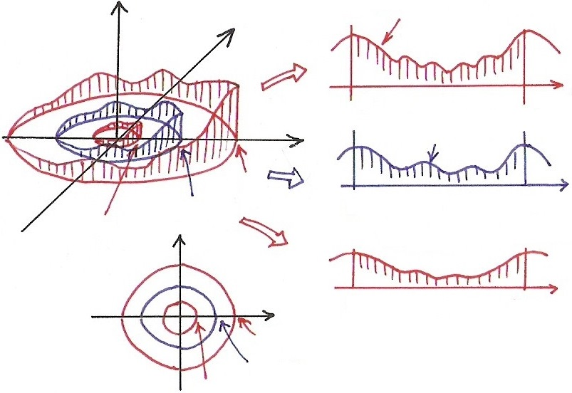
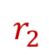

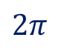
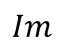

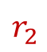
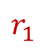
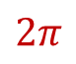
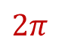

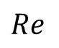
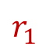
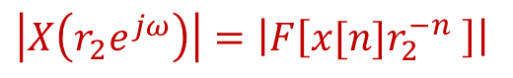
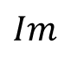

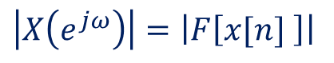
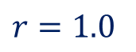

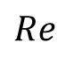
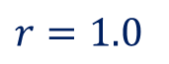

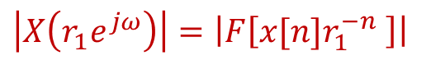
Z-Transform
$$\left|X\left(r_{1}e^{jω}\right)\right|=\left|F\left[x[n]r_{1}^{−n} \right]\right|$$
$$Im$$
$$ω$$
$$0$$
$$2π$$
$$Re$$
$$\left|X\left(e^{jω}\right)\right|=\left|F\left[x[n] \right]\right|$$
$$ω$$
$$r_{1}$$
$$r=1.0$$
$$0$$
$$2π$$
$$r_{2}$$
$$Im$$
$$\left|X\left(r_{2}e^{jω}\right)\right|=\left|F\left[x[n]r_{2}^{−n} \right]\right|$$
$$ω$$
$$Re$$
$$0$$
$$2π$$
$$r_{1}$$
$$r=1.0$$
$$r_{2}$$

Slide 8
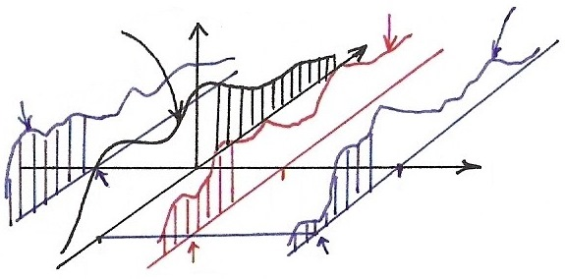
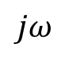
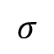
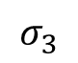
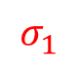
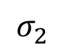
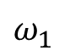
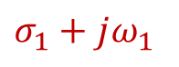
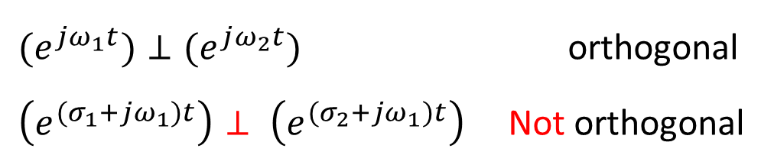
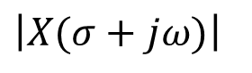
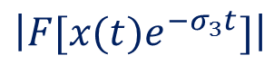
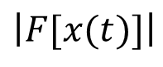
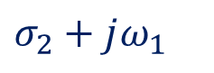
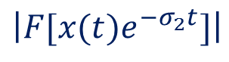
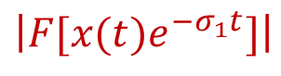
Laplace Transform (p.5 of 9.0)
$$\left|F[x(t)e^{−σ_{1}t}]\right|$$
$$\left|F[x(t)e^{−σ_{2}t}]\right|$$
$$\left|F[x(t)]\right|$$
$$\left|X(σ+jω)\right|$$
$$\left|F[x(t)e^{−σ_{3}t}]\right|$$
$$σ_{2}+jω_{1}$$

Slide 9
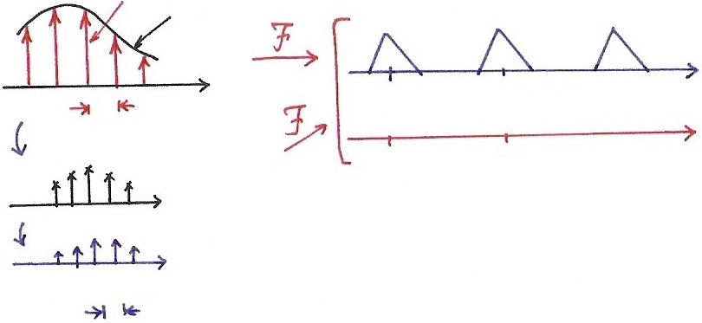
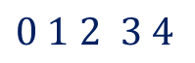
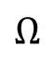
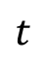
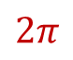
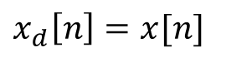

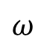

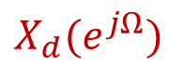


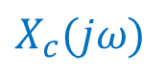
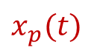

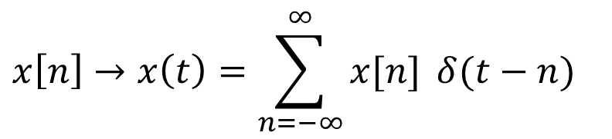






Z-Transform
$$x_{p}(t)$$
$$X_{c}(jω)$$
$$X_{p}(jω)$$
$$x_{c}(t)$$
$$ω$$
$$t$$
$$\frac{2π}{T}$$
$$0$$
$$T$$
$$X_{d}(e^{jΩ})$$
$$Ω$$
$$x_{d}\left[n\right]=x[n]$$
$$0$$
$$2π$$
$$n$$
$0$ $1$ $2$ $3$ $4$
$$x\left[n\right]→x\left(t\right)=\sum_{n=−∞}^{∞}{x[n]} δ(t−n)$$
$$t$$
$$x(t)$$
$0$ $1$ $2$ $3$ $4$
$$1$$

Slide 10









Z-Transform
$$jω$$
s-plane
$F\left\{x(t)e^{{−σ}_{1}t}\right\}$
$$=F\{(\sum_{n}{x\left[n\right]}δ\left(t−n\right))⋅e^{{−σ}_{1}t}\}$$
$$=F\{\sum_{n}{x\left[n\right]} e^{{−σ}_{1}n} δ(t−n)\}$$
$$σ$$
$=r_{1}^{−n}$, $r_{1}=e^{σ_{1}}$
$$σ_{2}$$
$$σ_{1}$$
$F\left\{x(t)e^{{−σ}_{2}t}\right\}$
$$=F\{\sum_{n}{x\left[n\right]} e^{{−σ}_{2}n} δ(t−n)\}$$
$=r_{2}^{−n}$, $r_{2}=e^{σ_{2}}$

Slide 11










Z-Transform
$$σ_{1}+jΩ$$
$$jΩ$$
s-plane
$$σ_{2}+jΩ$$
$$2π$$
$$σ$$
$$0$$
$$σ_{2}$$
$$σ_{1}$$
$$F\left\{x(t)e^{{−σ}_{1}t}\right\}$$

Slide 12






















Z-Transform
$$jΩ$$
$$Im$$
z-plane
$$z=e^{s}$$
s-plane
$$2π$$
$$r=1.0$$
$$Re$$
$$σ$$
$$σ_{1}$$
$$σ_{2}$$
$$0$$
$$r_{2}=e^{σ_{2}}$$
$$r_{1}=e^{σ_{1}}$$
$$jΩ$$
$$Im$$
s
$$2π$$
z
$e^{(σ_{0}+jω)}$
$$=e^{σ_{0}}⋅e^{j}$$
$$σ$$
$$Re$$
$$ω$$
$$r_{0}$$
$$Ω$$

Slide 13













Z-Transform
$L[x(t)]$
$$=\int_{−∞}^{∞}{[\sum_{n}{x\left[n\right]}δ(t−n)]}e^{−st}dt$$
$$=\sum_{n}{x\left[n\right]}e^{−s n}\text{ =}\sum_{n}{x\left[n\right]z^{−n}}\text{ =}Z[x[n]]$$
$$=z^{−1}$$
$$ω$$
$$ω$$
$$r_{1}$$
$$r_{2}$$
$$0$$
$$ω_{1}$$
$$ω_{2}$$
$$2π$$
$$\left(e^{jω_{1}n}\right)⊥\left(e^{jω_{2}n}\right)$$
$${ (r_{1}e^{jω})}^{n}⊥{(r_{2}e^{jω})}^{n}$$
orthogonal
Not orthogonal

Slide 14
Z-Transform
A Generalization of Fourier Transform
reduces to Fourier Transform
X(z) may not be well defined (or converged) for all z
X(z) may converge at some region of z-plane, while x[n] doesn’t have Fourier Transform
covering broader class of signals, performing more analysis for signals/systems

Slide 15
Z-Transform
Rational Expressions and Poles/Zeros
roots zeros
roots poles
In terms of z, not z⁻¹
Pole-Zero Plots
specifying X(z) except for a scale factor

Slide 16







Z-Transform
$$Im$$
$$Im$$
$$z^{−1}$$
$$z$$
$$Re$$
$$Re$$

Slide 17
Z-Transform
Rational Expressions and Poles/Zeros
Geometric evaluation of Fourier/Z-Transform from pole-zero plots
each term (z-β_{i}) or (z-α_{j}) represented by a vector with magnitude/phase

Slide 18





















Poles & Zeros (p.9 of 9.0)
$$\left|X(jω)\right|$$
$$\left|X(σ_{3}+jω)\right|$$
x
x

Slide 19




















Poles & Zeros
$$Im$$
$$r_{3}$$
$$\left|r_{1}−1\right|$$
$$1.0$$
$$r_{3}$$
$$\left|r_{2}−1\right|$$
$$Re$$
$$ω_{2}$$
$$ω$$
$$ω_{1}$$
$$r_{1}e^{jω_{1}}$$
$$ω_{1}$$
$$ω_{2}$$
$$r_{2}e^{jω_{2}}$$
$$Im$$
$$1.0$$
zero
pole
$$\left|{X(r}_{3}e^{jω})\right|$$
$$Re$$
$$r_{3}$$

Slide 20
Z-Transform (p.12 of 10.0)
$$jΩ$$
$$Im$$
z-plane
$$z=e^{s}$$
s-plane
$$2π$$
$$r=1.0$$
$$Re$$
$$σ$$
$$σ_{1}$$
$$σ_{2}$$
$$0$$
$$r_{2}=e^{σ_{2}}$$
$$r_{1}=e^{σ_{1}}$$
$$jΩ$$
$$Im$$
s
$$2π$$
z
$e^{(σ_{0}+jω)}$
$$=e^{σ_{0}}⋅e^{j}$$
$$σ$$
$$Re$$
$$ω$$
$$r_{0}$$
$$Ω$$

Slide 21
Z-Transform
Rational Expressions and Poles/Zeros
Geometric evaluation of Fourier/Z-transform from pole-zero plots
Example : 1st-order
See Example 10.1, p.743~744 of text
See Fig. 10.13, p.764 of text

Slide 22


Slide 23
Z-Transform
Rational Expressions and Poles/Zeros
Geometric evaluation of Fourier/Z-transform from pole-zero plots
Example : 2nd-order
See Fig. 10.14, p.766 of text

Slide 24


Slide 25
Z-Transform
Rational Expressions and Poles/Zeros
Specification of Z-Transform includes the region of convergence (ROC)
Example :
See Example 10.1, 10.2, p.743~745 of text

Slide 26


Slide 27


Slide 28
Z-Transform
Rational Expressions and Poles/Zeros
x[n] = 0, n < 0
X(z) involes only negative powers of z initially
x[n] = 0, n > 0
X(z) involes only positive powers of z initially
poles at infinity if
degree of N(z) > degree of D(z)
zeros at infinity if
degree of D(z) > degree of N(z)

Slide 29
Z-Transform (p.4 of 10.0)
$$n$$
-3 -2 -1 0 1 2 3
$z^{3}$ $z^{2}$ $z$ 1 $z^{−1}$ $z^{−2}$ $z^{−3}$

Slide 30
Region of Convergence (ROC)
Property 1 : The ROC of X(z) consists of a ring in
the z-plane centered at the origin
for the Fourier Transform of x[n]r^{-n} to converge
, depending on r
only, not on ω
the inner boundary may extend to include the origin, and the outer boundary may extend to infinity
Property 2 : The ROC of X(z) doesn’t include any
poles

Slide 31








Property 1
$$jΩ$$
$$Im$$
s-plane
$$1.0$$
z-plane
$$2π$$
$$σ$$
$$Re$$
$$0$$

Slide 32
Region of Convergence (ROC)
Property 3 : If x[n] is of finite duration, the ROC is
the entire z-plane, except possibly for z = 0 and/or z = ∞
If
If
If

Slide 33















Property 3, 4, 5
X
X
X
X
X
X
X
X
X
X
$$n$$
$$n$$
-4 -3 -2 -1 0 1 2 3 4
$$N_{1}$$
$$\sum_{n}{\left|x[n]\right|}r_{1}^{−n} r_{1}>r_{0}$$
$z^{4} z^{3}$ $z^{2}$ $z$ 1 $z^{−1}$ $z^{−2}$ $z^{−3}$
$$z^{−4}$$
$$={(\frac{r_{1}}{r_{0}})}^{−n}\left\{\sum_{n}{\left|x[n]\right|}r_{0}^{−n}\right\}$$
$$N_{2}$$
$$N_{1}$$
$$N_{1}$$
$$<{( \frac{r_{1}}{r_{0}} )}^{−N_{1}}⋅\left\{ \sum_{n}{\left|x[n]\right|}r_{0}^{−n} \right\}$$
$$N_{2}$$
$$>1$$
$$<∞$$

Slide 34
Region of Convergence (ROC)
Property 4 : If x[n] is right-sided, and {z | |z| =
r₀ }⊂ROC, then {z | ∞ > |z| > r₀}⊂ROC
If
If

Slide 35
Region of Convergence (ROC)
Property 5 : If x[n] is left-sided and {z | |z| =
r₀}⊂ROC, then {z | 0 < |z| < r₀}⊂ROC
If
If

Slide 36
Region of Convergence (ROC)
Property 6 : If x[n] is two-sided, and {z | |z| =
r₀}∈ROC, then ROC consists of a ring
that includes {z | |z| = r₀}
a two-sided x[n] may not have ROC

Slide 37
Region of Convergence (ROC)
Property 7 : If X(z) is rational, then ROC is
bounded by poles or extends to zero or infinity
Property 8 : If X(z) is rational, and x[n] is right-
sided, then ROC is the region outside the outermost pole, possibly includes z = ∞. If in addition x[n] = 0, n < 0, ROC also includes z = ∞

Slide 38
Region of Convergence (ROC)
Property 9 : If X(z) is rational, and x[n] is left-sided,
the ROC is the region inside the innermost pole, possibly includes z = 0. If in addition x[n] = 0, n > 0, ROC also includes z = 0
See Example 10.8, p.756~757 of text
Fig. 10.12, p.757 of text

Slide 39


Slide 40
Inverse Z-Transform
integration along a circle counterclockwise,
{z | |z| = r₁}∈ROC, for a fixed r₁

Slide 41



Laplace Transform (p.28 of 9.0)
X
(basis?)
X
(合成 ?)
X
(分析 ?)
$$≠\vec{A}⋅\vec{v}$$
(分析)
$${\left[e^{\left(σ_{1}+jω\right)t}\right]}^{∗}=e^{σ_{1}t}⋅e^{−jωt}$$
basis
$${x\left(t\right)e}^{{−σ}_{1}t}=\frac{1}{2π}\int_{−∞}^{∞}{X(σ_{1}+jω)}e^{jωt} dt$$
(合成)
$$X(σ_{1}+jω)=\int_{−∞}^{∞}{[x\left(t\right)e^{{−σ}_{1}t}]}⋅e^{−jωt}dt$$
(分析)

Slide 42







Z-Transform
X
basis?
$$x\left[n\right]=\frac{1}{2π}\int_{2π}{X}\left(r_{1}e^{jω}\right){\left(r_{1}e^{jω}\right)}^{n} dω$$
X
(合成?)
$$X(r_{1}e^{jω})=\sum_{n}{x[n]}{\left(r_{1}e^{jω}\right)}^{−n}$$
X
(分析?)
$$≠$$
$≠\vec{A}⋅\vec{v}$ (分析)
$${[{(r_{1}e^{jω})}^{n}]}^{∗}=r_{1}^{n}⋅e^{jωn}$$
basis
$$x\left[n\right]r_{1}^{−n}=\frac{1}{2π}\int_{2π}{X}\left(r_{1}e^{jω}\right)(e^{jωn}) dω$$
(合成)
$$X(r_{1}e^{jω})=\sum_{n}{(x\left[n\right]r_{1}^{−n})e^{−jωn} }$$
(分析)

Slide 43

Z-Transform (p.13 of 10.0)
$L[x(t)]$
$$=\int_{−∞}^{∞}{[\sum_{n}{x\left[n\right]}δ(t−n)]}e^{−st}dt$$
$$=\sum_{n}{x\left[n\right]}e^{−s n}\text{ =}\sum_{n}{x\left[n\right]z^{−n}}\text{ =}Z[x[n]]$$
$$=z^{−1}$$
$$ω$$
$$ω$$
$$r_{1}$$
$$r_{2}$$
$$0$$
$$ω_{1}$$
$$ω_{2}$$
$$2π$$
$$\left(e^{jω_{1}n}\right)⊥\left(e^{jω_{2}n}\right)$$
$${ (r_{1}e^{jω})}^{n}⊥{(r_{2}e^{jω})}^{n}$$
orthogonal
Not orthogonal

Slide 44
Inverse Z-Transform
Partial-fraction expansion practically useful:
ROC outside the pole at
ROC inside the pole at

Slide 45
Inverse Z-Transform
Partial-fraction expansion practically useful:
Example:
See Example 10.9, 10.10, 10.11, p.758~760 of text

Slide 46





Example
$$Im$$
$$\frac{1}{4}$$
$$\frac{1}{3}$$
$$Re$$

Slide 47
Inverse Z-Transform
Power-series expansion practically useful:
right-sided or left-sided based on ROC

Slide 48
Inverse Z-Transform
Power-series expansion practically useful:
Example:
See Example 10.12, 10.13, 10.14, p.761~763 of text
Known pairs/properties practically helpful

Slide 49
10.2 Properties of Z-Transform
Linearity
ROC = R₁∩ R₂ if no pole-zero cancellation

Slide 50









Linearity & Time Shift
Time Shift
Linearity
$$x\left[n−1\right]$$
$F\left\{\left(ax_{1}\left[n\right]+bx_{2}\left[n\right]\right)r^{−n}\right\}$
$$=F\left\{ax_{1}\left[n\right]r^{−n}\}+F\{bx_{2}\left[n\right]r^{−n}\right\}$$
$$x\left[n\right]$$
$$n$$
-3 -2 -1 0 1 2 3
$$n$$
-2 -1 0 1 2 3 4
$z^{3} z^{2}$ $z$ 1 $z^{−1}$ $z^{−2}$ $z^{−3}$
$z^{2}$ $z^{1}$ 1 $z^{−1}$ $z^{−2}$ $z^{−3}$ $z^{−4}$
$$X(z)$$
$$z^{−1}X(z)$$

Slide 51

Time Shift
ROC = R, except for possible addition or deletion of the origin or infinity
n₀ > 0, poles introduced at z = 0 may cancel zeros at z = 0
n₀ < 0, zeros introduced at z = 0 may cancel poles at z = 0
Similarly for z = ∞
$$x\left[n−n_{0}\right]↔e^{−jω{ n}_{0}} X(e^{jω})$$
$$x(t−t_{0})↔e^{−s{ t}_{0}} X(s)$$

Slide 52
Scaling in z-domain
Pole/zero at z = a → shifted to z = z₀a
rotation in z-plane by ω₀
See Fig. 10.15, p.769 of text
pole/zero rotation by ω₀ and scaled by r₀

Slide 53





Scaling in Z-domain
$$z_{0}^{n}x\left[n\right]↔\sum_{n}{\left(z_{0}^{n}x\left[n\right]\right)z^{−n}}=\sum_{n}{x[n]}{(\frac{z}{z_{0}})}^{−n}$$
Shift in frequency domain
$$e^{jω_{0}n}x\left[n\right]↔X( e^{j\left(ω−ω_{0}\right)} )$$
$$e^{s_{0}t}x(t)↔X( s−s_{0} )$$
$$\frac{re^{jω}}{r_{0}e^{jω_{0}}}=\frac{z}{z_{0}}$$
$$e^{{(s−s}_{0})}=\frac{e^{s}}{e^{s_{0}}}=\frac{z}{z_{0}}$$

Slide 54











Shift in s-plane (p.33 of 9.0)
$$s_{0}=jω_{0}$$
$$\left|X(j\left(ω−ω_{0}\right))\right|$$
$$\left|X(σ+jω)\right|$$
$$Re[s_{0}]$$
$$\left|X(jω)\right|$$

Slide 55


Slide 56




Time Reversal
$${X(z}^{−1})$$
$x[−3]$ $x[−2]$ $x[−1]$ $x[0]$ $x[1]$ $x[2]$ $x[3]$
$z^{3}$ $z^{2}$ $z^{1}$ 1 $z^{−1}$ $z^{−2}$ $z^{−3}$
$$X(z)$$
right-sided ↔ left-sided

Slide 57









Time Expansion
- pole/zero at $z=a→$ shifted to
$z=a^{1/k}$
$$n$$
$$X(z)$$
0 1 2
1 $z^{−1}$ $z^{−2}$
$$n$$
$${X(z}^{k})$$
0 3 6
1 $z^{−3}$ $z^{−6}$

Slide 58

(p.39 of 5.0)

Slide 59









Time Expansion (p.40 of 5.0)
$$e^{−jω}$$
$$e^{−j3ω}$$
1
1
$$e^{−j2ω}$$
$$e^{j3ω}$$
$$e^{−j6ω}$$
$$e^{jω}$$
$$n$$
$$n$$
-1 01 2
-3 0 3 6
$\left(kω\right)3ω$ $\left(kω\right)3ω$
$$X\left(e^{jω}\right)=\sum_{n=−∞}^{∞}{x[n]}e^{−jωn}$$

Slide 60







Conjugation
if x[n] is real
a pole/zero at z = z₀ → a pole/zero at
$$x^{∗}[n]\underset{↔}{F}X^{∗}(e^{−jω})$$
$$x^{∗}[n]↔\sum_{n}{x^{∗}[n]}z^{−n}$$
$$x^{∗}(t)\underset{↔}{L}X^{∗}(s^{∗})$$
$${=[\sum_{n}{x\left[n\right]}{{(z}^{∗})}^{−n}]}^{∗}$$
$$x^{∗}[n]\underset{↔}{Z}X^{∗}(z^{∗})$$
$$e^{s^{∗}}=e^{σ−jω}=e^{σ}e^{−jω}$$
$=z^{∗}$
$$=x^{∗}(z^{∗})$$

Slide 61







Convolution
ROC may be larger if pole/zero cancellation occurs
power series expansion interpretation
$$X_{1}(z)$$
$$X_{2}(z)$$
$$z^{−3}$$
$$⋯x_{1}\left[0\right]x_{2}\left[3\right]+x_{1}\left[1\right]x_{2}\left[2\right]+x_{1}\left[2\right]x_{2}\left[1\right]+x_{1}\left[3\right]x_{2}\left[0\right]⋯$$
$$y\left[3\right]=\sum_{k}{x_{1}\left[k\right]x_{2}\left[3−k\right]}$$
$$y\left[n\right]=x_{1}\left[n\right]∗x_{2}\left[n\right]$$
$$Y\left(z\right)=X_{1}(z)⋅X_{2}(z)$$

Slide 62
Multiplication (p.33 of 3.0)
Conjugation

Slide 63

Multiplication (p.31 of 3.0)
$$\underset{}{\underbrace{(⋯,a_{0}b_{3}+a_{1}b_{2}+a_{2}b_{1}+a_{3}b_{0},⋯)}e^{j3ω_{0}^{}t}}$$
$$d_{3}=\sum_{j}{a_{j}b_{3−j}}$$

Slide 64

First Difference/Accumulation
ROC = R with possible deletion of z = 0
and/or addition of z = 1
${1−z}^{−1}$: ROC$=\left\{z | \left|z\right|>0\right\}$
a zero at $z=1$
a pole at $z=0$

Slide 65




First Difference/Accumulation
$$\sum_{k=−∞}^{n}{x[k]}=x[n]∗u[n]$$
$$u\left[n\right]\underset{↔}{z}U\left(z\right)=\frac{1}{1−z^{−1}}$$
, ROC$=\{\left|z\right|>1\}$

Slide 66
Differentiation in z-domain
Initial-value Theorem
Summary of Properties/Known Pairs
See Tables 10.1, 10.2, p.775, 776 of text

Slide 67


Slide 68


Slide 69
10.3 System Characterization with
Z-Transform
x[n]
y[n]=x[n]＊h[n]
h[n]
X(z)
H(z)
Y(z)=X(z)H(z)
system function, transfer function

Slide 70
Causality
A system is causal if and only if the ROC of H(z) is the exterior of a circle including infinity (may extend to include the origin in some cases)
right-sided
A system with rational H(z) is causal if and only
if (1)ROC is the exterior of a circle outside the
outermost pole including infinity
or (2)order of N(z) ≤ order of D(z)
H(z) finite for z → ∞

Slide 71
Causality (p.44 of 9.0)
A causal system has an H(s) whose ROC is a right-half plane
h(t) is right-sided
For a system with a rational H(s), causality is equivalent to its ROC being the right-half plane to the right of the rightmost pole
Anticausality
a system is anticausal if h(t) = 0, t > 0
an anticausal system has an H(s) whose ROC is a left-half plane, etc.

Slide 72








Causality (p.45 of 9.0)
right-sided
Causal
ROC
is
right half Plane
X
$$X\left(s\right)=\sum_{i}{\frac{A_{i}}{s+a_{i}}} ,$$
$$\frac{A_{i}}{s+a_{i}} →A_{i}e^{−a_{i}t}u(t)$$
Causal

Slide 73
Z-Transform (p.4 of 10.0)
$$n$$
-3 -2 -1 0 1 2 3
$z^{3}$ $z^{2}$ $z$ 1 $z^{−1}$ $z^{−2}$ $z^{−3}$

Slide 74
Stability
A system is stable if and only if ROC of H(z) includes the unit circle
Fourier Transform converges, or absolutely summable
A causal system with a rational H(z) is stable if and only if all poles lie inside the unit circle
ROC is outside the outermost pole

Slide 75
Systems Characterized by Linear Difference Equations
zeros
poles
difference equation doesn’t specify ROC
stability/causality helps to specify ROC

Slide 76
Interconnections of Systems
Parallel
H₁(z)
H(z)=H₁(z)+H₂(z)
H₂(z)
Cascade
H₁(z)
H₂(z)
H(z)=H₁(z)H₂(z)

Slide 77
Interconnections of Systems
Feedback
+
H₁(z)
＋
－
H₂(z)

Slide 78
Block Diagram Representation
Example:
direct form, cascade form, parallel form
See Fig. 10.20, p.787 of text

Slide 79


Slide 80
10.4 Unilateral Z-Transform
Z{x[n]u[n]} = Z_{u}{x[n]}
for x[n] = 0, n < 0, X(z)_{u} = X(z)
ROC of X(z)_{u} is always the exterior of a circle including z = ∞
degree of N(z) ≤ degree of D(z) (converged for z = ∞)

Slide 81
10.4 Unilateral Z-Transform
Time Delay Property (different from bilateral case)
Time Advance Property (different from bilateral case)

Slide 82



















Time Delay Property/Time Advance Property
$$x[n]$$
$$x[n−1]$$
$$x[n]$$
$$x[n+1]$$
-2 -1 0 1 2 3 4 5
$$n$$
$$n$$
0 1 2 3 4
$$n$$
-1 0 1 2 3 4 5 6
$$n$$
-1 0 1 2 3
$1$ $z^{−1}$ $z^{−2}$ $z^{−3}$ $z^{−4}$ $z^{−5}$
$$X{\left[Z\right]}_{u}$$
$$1$$
$z^{−1}$ $z^{−2}$ $z^{−3}$ $z^{−4}$
$$X{(z)}_{u}$$
$$1$$
$z^{−1}$ $z^{−2}$ $z^{−3}$ $z^{−4}$ $z^{−5}$ $z^{−6}$
$$z^{−1} X{\left[Z\right]}_{u}$$
$1$ $z^{−1}$ $z^{−2}$ $z^{−3}$
$$zx\left[0\right]$$

Slide 83
10.4 Unilateral Z-Transform
Convolution Property
this is not true if x₁[n] , x₂[n] has nonzero values for n < 0

Slide 84











Convolution Property
$x_{1}\left[n\right]=0$, $n<0$
$x_{2}\left[n\right]=0$, $n<0$
$→$ $x_{1}\left[n\right]∗x_{2}\left[n\right]=0$, $n<0$
$$x_{1}\left[n\right]$$
0 1 2 3
$$x_{2}\left[n\right]$$
$$x_{1}\left[n\right]\underset{↔}{Z}X_{1}\left(z\right)=X_{1}{(z)}_{u}$$
$$x_{2}\left[n\right]\underset{↔}{Z}X_{2}\left(z\right)=X_{2}{(z)}_{u}$$
$$y\left[n\right]\underset{↔}{Z} Y\left(z\right)= Y{(z)}_{u}$$
$$∗$$
$$⋅$$
$$⋅$$
0 1 2 3
$$∥$$
$$∥$$
$$∥$$

Slide 85

Examples
Example 10.4, p.747 of text

Slide 86
Examples
Example 10.6, p.752 of text

Slide 87

Examples
Example 10.6, p.752 of text

Slide 88
Examples
Example 10.17, p.772 of text

Slide 89


Examples
Example 10.31, p.788 of text (Problem 10.38, P.805 of text)

Slide 90
Problem 10.12, p.799 of text

Slide 91




Problem 10.12, p.799 of text
double
pole
double
zero
$0$ $π$ $2π$
$0$ $π$ $2π$
$0$ $π$ $2π$
Highpass
Lowpass
Bandpass

Slide 92
Problem 10.44, p.808 of text
n: even

Slide 93
Problem 10.46, p.808 of text
8-th order pole at z=0 and 8 zeros
causal and stable
8-th order zero at z=0 and 8 poles
causal and stable

Slide 94






Problem 10.46, p.808 of text
$$H\left[z\right]$$
$$G\left[z\right]$$
8-th order zero
8-th order pole
$$\frac{π}{4}$$
$$e^{α}$$
$$e^{α}$$
x[n]
y[n]
y[n]
x[n]
+
……
_
H(z)
G(z)

